Slide 1
DATABASE MANAGEMENT SYSTEMS

Slide 2
UNIT-I
Introduction to Database Management System
Database system Applications
Advantages of DBMS over File System
Data Models
Instances and schema
View of Data
Database Languages -DDL-DML
Database Users and Administrator
Database System Structure

Slide 3
Database Design and ER diagrams
Attributes and Entity Sets
Relationships and Relationship Sets
Constraints -Keys
Design Issues
Entity-Relationship Diagram
Weak Entity Sets
Extended E-R Features
Database Design with ER model
Database Design for Banking Enterprise

Slide 4
UNIT –II
Introduction to the Relational Model
Structure of RDBMS
Integrity Constraints over Relations -Enforcing Integrity Constraints
Querying Relational Data -Relational Algebra and Calculus.
Introduction to SQL-Data Definition commands
Data Manipulation Commands
Basic Structure, Set operations , Aggregate Operations
Join operations
Sub queries and correlated queries
SQL functions , views ,Triggers, Embedded SQL.

Slide 5
UNIT –III
Introduction to the SQL (Structured Query Language and all their practical implementation)

Slide 6
UNIT –IV
Functional Dependencies–Introduction
Basic Definitions, Trivial and Non trivial dependencies
closure of a set of dependencies, closure of attributes
irreducible set of dependencies
Schema Refinement in Database-Design-Problems Caused by Redundancy
Decompositions –Problem Related to Decomposition
Lossless Join Decomposition
Dependency Preserving Decomposition
FIRST, SECOND, THIRD Normal Forms
BCNF ––Multi valued Dependencies
Fourth Normal Form.

Slide 7
UNIT-V
Transaction concept
Transaction state
Implementation of atomicity and Durability
Concurrent executions -Serializability, Recoverability
File Organization –Organization of records in file
Data Dictionary Storage
Indexing and Hashing
Basic Concepts , Ordered Indices
B+Tree Index files, B-tree index files

Slide 8
TEXT BOOKS
Database System Concepts, Silberschatz, Korth , Sixth Edition, McGraw hill ( 1,2,3 and 5 Units)
Introduction to Database Systems, C.J.Date, Pearson Education (4thUnit)
REFERENCES:
Fundamentals of Database Systems, Elmasri Navate Pearson Education
Database Management Systems, Raghu Ramakrishnan, Johannes Gehrke, TATA Mc Graw Hill(1,2,3 and 5 Units)
Data base Systems design, Implementation, and Management, Peter Rob and Carlos Coronel 7th Edition.
Data Base Systems using Oracle: A simplified guide to SQL and PL /SQL, Shah, PHI

Slide 9

Database Management Systems, Raghu Ramakrishnan, Johannes Gehrke, TATA Mc Graw Hill(1,2,3 and 5 Units)

Slide 10
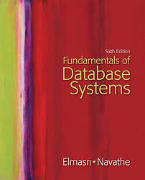
Fundamentals of Database Systems, Elmasri Navate Pearson Education

Slide 11

Database System Concepts, Silberschatz, Korth , Sixth Edition, McGraw hill ( 1,2,3 and 5 Units)

Slide 12
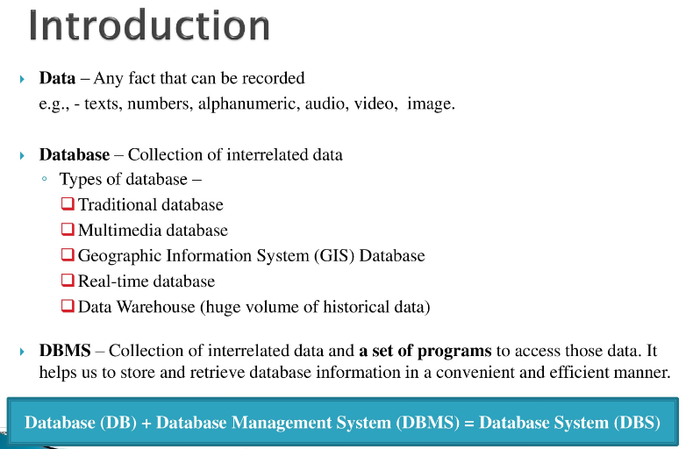


Slide 13
1.Introduction to Database Management System
A database-management system (DBMS) is a collection of interrelated data and a set of programs to access those data.
The collection of data referred to as the database which contains information relevant to an enterprise.
The primary goal of a DBMS is to provide a way to store and retrieve database information that is both convenient and efficient

Slide 14
1.Introduction to Database Management System
Database Management System (DBMS): A software package/ system to facilitate the creation and maintenance of a computerized database.
It defines (data types, structures, constraints), construct (storing data on some storage medium controlled by DBMS) and manipulate (querying, update, report generation) databases for various applications.
.

Slide 15
1.Introduction to Database Management System
A Database Management System (DBMS) is a software package designed to store and manage databases:
  Manages very large amounts of data.
  2. Supports efficient access to very large amounts of data.
  3. Supports concurrent access to very large amounts of data.
    Example: bank and its ATM machines.
  Supports secure, atomic access to very large amounts of data.

Slide 16
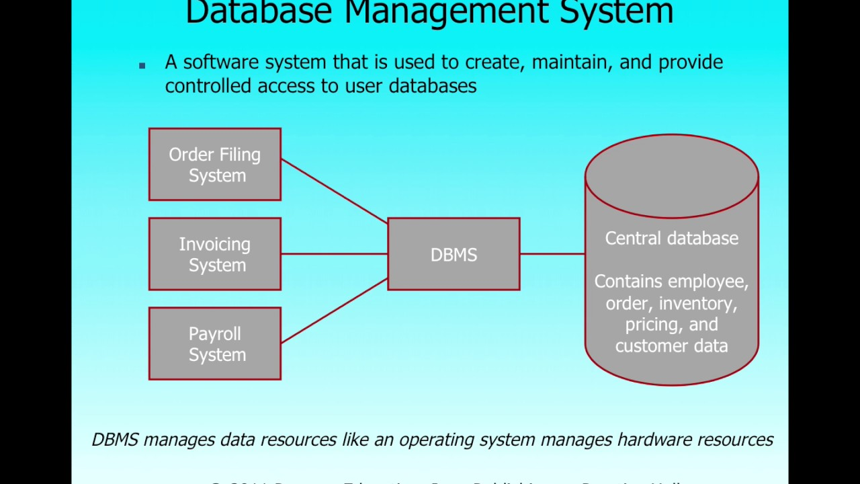
1.Introduction to Database Management System

Slide 17
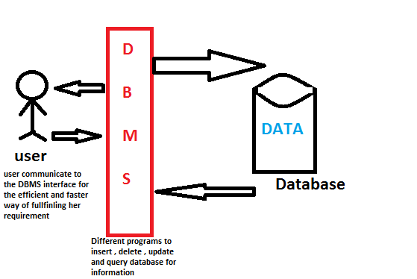
1.Introduction to Database Management System

Slide 18
1.Introduction to Database Management System
Database systems are designed to manage large bodies of information.
Management of data involves both defining structures for storage of information and providing mechanisms for the manipulation of information.

Slide 19
1.Introduction to Database Management System
The database system must ensure the safety of the information stored, despite system crashes or attempts at unauthorized access.
If data are to be shared among several users, the system must avoid possible anomalous results.
Because information is so important in most organizations, computer scientists have developed a large body of concepts and techniques for managing data.

Slide 20
Advantages of DBMS
Data independence
Application programs should not be exposed to details of data representation and storage, The DBMS provides an abstract view of the data that hides such details.

Slide 21
Efficient Data Access
A DBMS utilizes a variety of sophisticated techniques to store and retrieve data efficiently.

Slide 22
Data Integrity and Security
If data is always accessed through the DBMS, the DBMS can enforce integrity constraints.
For example, before inserting salary information for an employee, the DBMS can check that the department budget is not exceeded.
The DBMS can enforce access controls that govern what data is visible to different classes of users.

Slide 23
Data Administration
When several users share the data, centralizing the administration of data can offer retrieval efficient.
DBA(Data base Administrator) responsible for organizing the data representation to minimize redundancy and for fine-tuning the storage of the data to make retrieval efficient.

Slide 24
Concurrent Access and Crash Recovery
A DBMS schedules concurrent accesses to the data in such a manner that users can think of the data as being accessed by only one user at a time.
The DBMS protects users from the effects of system failures.

Slide 25
Reduced Application Development Time
The DBMS supports important functions that are common to many applications accessing data in the DBMS.
DBMS applications are also likely to be more robust than similar stand-alone applications because many important tasks are handled by the DBMS

Slide 26
2.Database System Applications
Databases are widely used
Banking: For customer information, accounts, and loans, and banking transactions.
Airlines: For reservations and schedule information.
Universities: For student information, course registrations, and grades.

Slide 27
2.Database System Applications
Credit card transactions: For purchases on credit cards and generation of monthly statements.
Telecommunication: For keeping records of calls made, generating monthly bills, maintaining balances on prepaid calling cards, and storing information about the communication networks.
Finance: For storing information about holdings, sales, and purchases of financial instruments such as stocks and bonds.

Slide 28
2.Database System Applications
Sales: For customer, product, and purchase information.
Manufacturing: For management of supply chain and for tracking production of items in factories, inventories of items in warehouses/stores, and orders for items.
Human resources: For information about employees, salaries, payroll taxes and benefits, and for generation of paychecks.

Slide 29
Database Systems versus File Systems
Consider part of a savings-bank enterprise that keeps information about all customers and savings accounts.
One way to keep the information on a computer is to store it in operating system files.
To allow users to manipulate the information, the system has a number of application programs that manipulate the files

Slide 30
Database Systems versus File Systems
System programmers wrote these application programs to meet the needs of the bank.
New application programs are added to the system as the need arises.
Thus, as time goes by, the system acquires more files and more application programs.

Slide 31
Database Systems versus File Systems
This typical file-processing system is supported by a conventional operating system.
The system stores permanent records in various files, and it needs different application programs to extract records from, and add records to, the appropriate files.
Before database management systems (DBMSs) came along, organizations usually stored information in file systems.

Slide 32
Keeping organizational information in a file-processing system has a number of major disadvantages
Data redundancy and inconsistency.
Since different programmers create the files and application programs over a long period, the various files are likely to have different formats and the programs may be written in several programming languages.
The same information may be duplicated in several places (files).

Slide 33
example
The address and telephone number of a particular customer may appear in a file that consists of savings-account records and in a file that consists of checking-account records.
This redundancy leads to higher storage and access cost.
It may lead to data inconsistency.
That is, the various copies of the same data may no longer agree.
For example, a changed customer address may be reflected in savings-account records but not elsewhere in the system.

Slide 34
Difficulty in accessing data
Suppose that one of the bank officers needs to find out the names of all customers who live within a particular postal-code area.
The officer asks the data-processing department to generate such a list.

Slide 35
Difficulty in accessing data
conventional file-processing environments do not allow needed data to be retrieved in a convenient and efficient manner.
More responsive data-retrieval systems are required for general use.

Slide 36
Data isolation
Because data are scattered in various files, and files may be in different formats, writing new application programs to retrieve the appropriate data is difficult.

Slide 37
Integrity problems
The data values stored in the database must satisfy certain types of consistency constraints.
For example, the balance of a bank account may never fall below a prescribed amount (say, $100).
Developers enforce these constraints in the system by adding appropriate code in the various application programs.
when new constraints are added, it is difficult to change the programs to enforce them.
The problem is compounded when constraints involve several data items from different files.

Slide 38
Atomicity problems
A computer system, like any other mechanical or electrical device, is subject to failure.
In many applications, it is crucial that, if a failure occurs, the data be restored to the consistent state that existed prior to the failure.
Consider a program to transfer $50 from account A to account B.
If a system failure occurs during the execution of the program, it is possible that the $50 was removed from account A but was not credited to account B, resulting in an inconsistent database state.
Clearly, it is essential to database consistency that either both the credit and debit occur, or that neither occur.

Slide 39
Atomicity problems
That is, the funds transfer must be atomic—it must happen in its entirety or not at all.
It is difficult to ensure atomicity in a conventional file-processing system.

Slide 40
Concurrent-access anomalies
For the sake of overall performance of the system and faster response, many systems allow multiple users to update the data simultaneously.
In this environment, interaction of concurrent updates may result in inconsistent data.
Consider bank account A, containing $500.
If two customers withdraw funds (say $50 and $100 respectively) from account A at about the same time, the result of the concurrent executions may leave the account in an incorrect (or inconsistent) state.

Slide 41
Concurrent-access anomalies
Suppose that the programs executing on behalf of each withdrawal read the old balance, reduce that value by the amount being withdrawn, and write the result back.
If the two programs run concurrently, they may both read the value $500, and write back $450 and $400, respectively.
Depending on which one writes the value last, the account may contain either $450 or $400, rather than the correct value of $350.
Therefore, the system must maintain some form of supervision.
In file systems supervision is difficult to provide because data may be accessed by many different application programs that have not been coordinated previously.

Slide 42
Security problems
Not every user of the database system should be able to access all the data.
For example, in a banking system, payroll personnel need to see only that part of the database that has information about the various bank employees.
They do not need access to information about customer accounts.
But, since application programs are added to the system in an ad hoc manner, enforcing such security constraints is difficult.

Slide 43
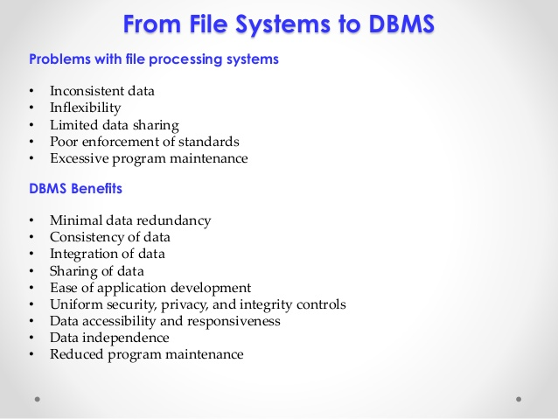

Slide 44
Data models
A data model is a collection of conceptual tools for describing data, data relationships, data semantics, and consistency constraints.
The entity–relationship (E-R) model is a high-level data model. It is based on a perception of a real world that consists of a collection of basic objects, called entities, and of relationships among these objects.
The relational model is a lower-level model. It uses a collection of tables to represent both data and the relationships among those data.
Today a vast majority of database products are based on the relational model.
Designers often formulate database schema design by first modeling data at a high level, using the E-R model, and then translating it into the relational model.

Slide 45
DBMS Database Models
A Database model defines the logical design and structure of a database and defines how data will be stored, accessed and updated in a database management system.
While the Relational Model is the most widely used database model, there are other models too:
Hierarchical Model
Network Model
Entity-relationship Model
Relational Model

Slide 46
Data Models
The structure of a database is the data model: a collection of conceptual Tools for describing data, data relationships, data semantics, and consistency constraints.
Data models provide a way to describe the design of a database at the logical level.

Slide 47
Hierarchical Model
This database model organizes data into a tree-like-structure, with a single root, to which all the other data is linked.
The hierarchy starts from the Root data, and expands like a tree, adding child nodes to the parent nodes.
In this model, a child node will only have a single parent node.
This model efficiently describes many real-world relationships like index of a book, recipes etc.
In hierarchical model, data is organized into tree-like structure with one one-to-many relationship between two different types of data, for example, one department can have many courses, many professors and of-course many students.

Slide 48
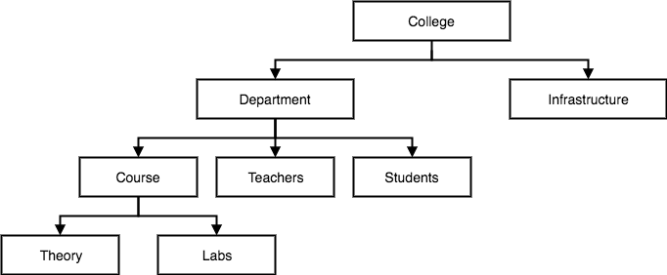
Hierarchical Model

Slide 49
Network Model
This is an extension of the Hierarchical model. In this model data is organized more like a graph, and are allowed to have more than one parent node.
In this database model data is more related as more relationships are established in this database model. Also, as the data is more related, hence accessing the data is also easier and fast.
This database model was used to map many-to-many data relationships.
This was the most widely used database model, before Relational Model was introduced.

Slide 50
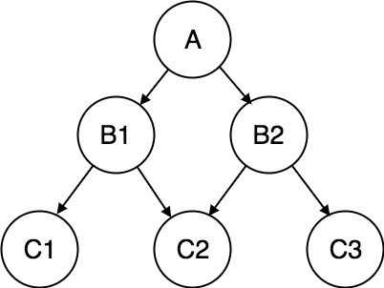
Network Model

Slide 51
The Entity-Relationship Model
The entity-relationship (E-R) data model is based on a perception of a real world that consists of a collection of basic objects, called entities, and of relationships among these objects.
An entity is a “thing” or “object” in the real world that is distinguishable from other objects.
For example, each person is an entity, and bank accounts can be considered as entities.

Slide 52
The Entity-Relationship Model
Entities are described in a database by a set of attributes.
For example, the attributes account-number and balance may describe one particular account in a bank, and they form attributes of the account entity set.
Similarly, attributes customer-name, customer-street address and customer-city may describe a customer entity.

Slide 53
The Entity-Relationship Model
A relationship is an association among several entities.
For example, a depositor relationship associates a customer with each account.

Slide 54
Entity-relationship Model
In this database model, relationships are created by dividing object of interest into entity and its characteristics into attributes.
Different entities are related using relationships.
E-R Models are defined to represent the relationships into pictorial form to make it easier for different stakeholders to understand.
This model is good to design a database, which can then be turned into tables in relational model.

Slide 55
Entity-relationship Model
The overall logical structure (schema) of a database can be expressed graphically by an E-R diagram, which is built up from the following components
Rectangles, which represent entity
Ellipses, which represent attributes
Diamonds, which represent relationships among entity sets
Lines, which link attributes to entity sets and entity sets to relationships

Slide 56
Entity-relationship Model
Each component is labeled with the entity or relationship that it represents
consider part of a database banking system consisting of customers and of the accounts that these customers have

Slide 57
Entity-relationship Model
The E-R diagram indicates that there are two entity sets, customer and account, with attributes.
The diagram also shows a relationship depositor between customer and account

Slide 58
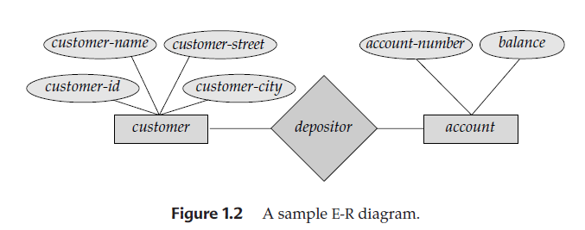
E-R DIAGRAM

Slide 59
Relational Model
The relational model uses a collection of tables to represent both data and the relationships among those data.
Each table has multiple columns, and each column has a unique name.

Slide 60
Relational Model
In this model, data is organised in two-dimensional tables and the relationship is maintained by storing a common field.
This model was introduced by E.F Codd in 1970, and since then it has been the most widely used database model, infact, we can say the only database model used around the world.
The basic structure of data in the relational model is tables. All the information related to a particular type is stored in rows of that table.
Hence, tables are also known as relations in relational model.

Slide 61
Relational Model
presents a sample relational database comprising three tables:
One shows details of bank customers, the second shows accounts, and the third shows which accounts belong to which customers.
Each table contains records of a particular type.
Each record type defines a fixed number of fields, or attributes.
The columns of the table correspond to the attributes of the record type

Slide 62
Relational Model
a special character (such as a comma) may be used to delimit the different attributes of a record, and another special character (such as a newline character) may be used to delimit records.
The relational model hides such low-level implementation details from database developers and users.

Slide 63
Relational Model
The relational model is at a lower level of abstraction than the E-R model.
Database designs are often carried out in the E-R model, and then translated to the relational model.

Slide 64
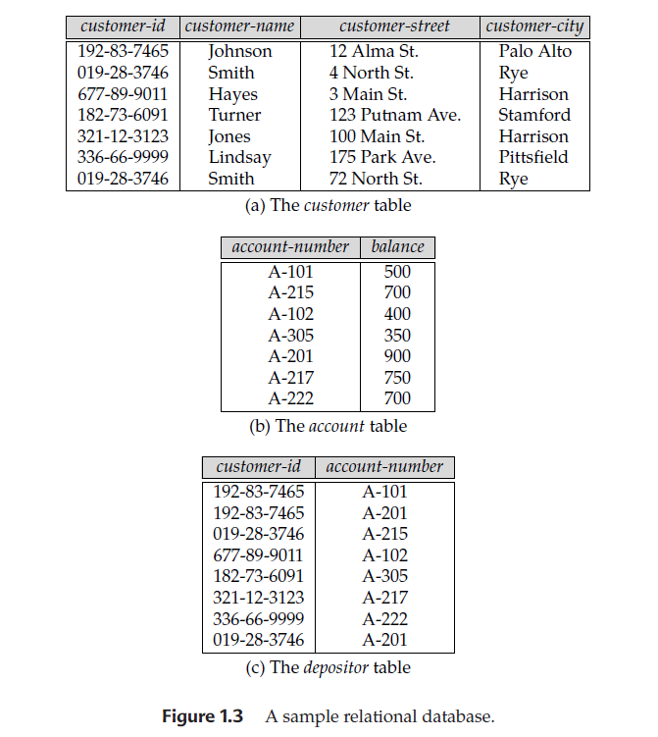
Relational Database

Slide 65
View of Data
A database system is a collection of interrelated files and a set of programs that allow users to access and modify these files.
A major purpose of a database system is to provide users with an abstract view of the data.
That is, the system hides certain details of how the data are stored and maintained.

Slide 66
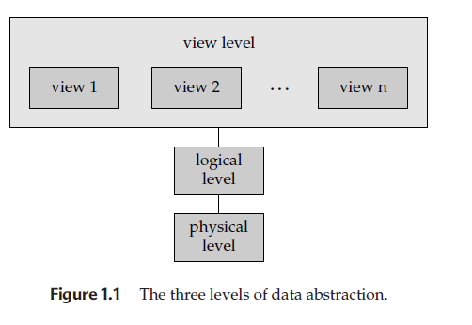
View of Data

Slide 67
Data Abstraction
For the system to be usable, it must retrieve data efficiently.
The need for efficiency has led designers to use complex data structures to represent data in the database.
Since many database-systems users are not computer trained, developers hide the complexity from users through several levels of abstraction, to simplify users’ interactions with the system

Slide 68
Physical level
The lowest level of abstraction describes how the data are actually stored.
The physical level describes complex low-level data structures in detail.

Slide 69
Logical level
The next-higher level of abstraction describes what data are stored in the database, and what relationships exist among those data.
The logical level thus describes the entire database in terms of a small number of relatively simple structures.
Although implementation of the simple structures at the logical level may involve complex physical-level structures, the user of the logical level does not need to be aware of this complexity.
Database administrators, who must decide what information to keep in the database, use the logical level of abstraction.

Slide 70
View level
The highest level of abstraction describes only part of the entire database.
Even though the logical level uses simpler structures, complexity remains because of the variety of information stored in a large database.
Many users of the database system do not need all this information.
They need to access only a part of the database.
The view level of abstraction exists to simplify their interaction with the system.
The system may provide many views for the same database.

Slide 71
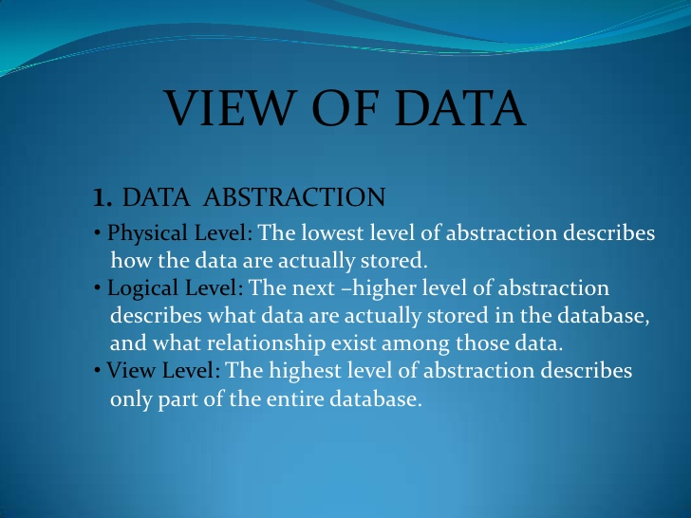

Slide 72
View level
account, with fields account-number and balance
employee, with fields employee-name and salary

Slide 73
Example: view of data
At the physical level, a customer, account, or employee record can be described as a block of consecutive storage locations (for example, words or bytes).
The language compiler hides this level of detail from programmers.

Slide 74
Example: view of data
Similarly, the database system hides many of the lowest-level storage details from database programmers.
Database administrators may be aware of certain details of the physical organization of the data.

Slide 75
Example: view of data
At the logical level, each record is described by a type definition.
Programmers using a programming language work at this level of abstraction.
Similarly, database administrators usually work at this level of abstraction

Slide 76
Example: view of data
at the view level, computer users see a set of application programs that hide details of the data types.
Similarly, at the view level, several views of the database are defined, and database users see these views.
In addition to hiding details of the logical level of the database, the views also provide a security mechanism to prevent users from accessing certain parts of the database.
For example, tellers in a bank see only that part of the database that has information on customer accounts.
They cannot access information about salaries of employees.

Slide 77
Instances and Schemas
Databases change over time as information is inserted and deleted.
The collection of information stored in the database at a particular moment is called an instance of the database.
The overall design of the database is called the database schema.
Schemas are changed infrequently.

Slide 78
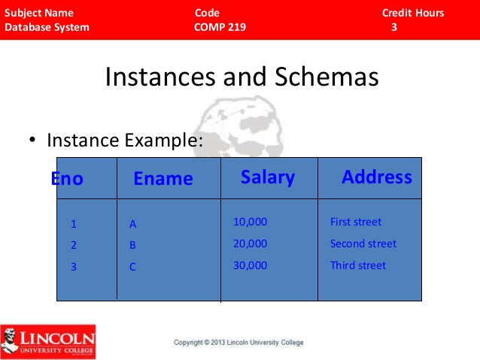

Slide 79
Instances and Schemas
A database schema corresponds to the variable declarations (along with associated type definitions) in a program.
Each variable has a particular value at a given instant.
The values of the variables in a program at a point in time correspond to an instance of a database schema

Slide 80
Instances and Schemas
Database systems have several schemas, partitioned according to the levels of abstraction.
The physical schema describes the database design at the physical level.
the logical schema describes the database design at the logical level.
A database may also have several schemas at the view level, sometimes called subschemas, that describe different views of the database

Slide 81
Instances and Schemas
programmers construct applications by using the logical schema.
The physical schema is hidden beneath the logical schema, and can usually be changed easily without affecting application programs.
Application programs are said to exhibit physical data independence if they do not depend on the physical schema, and thus need not be rewritten if the physical schema changes

Slide 82
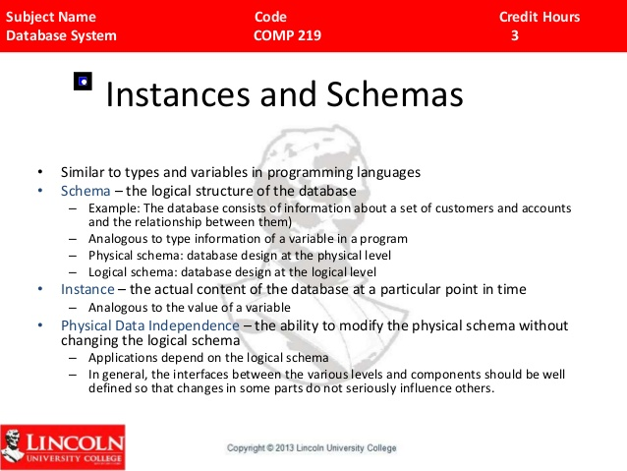

Slide 83
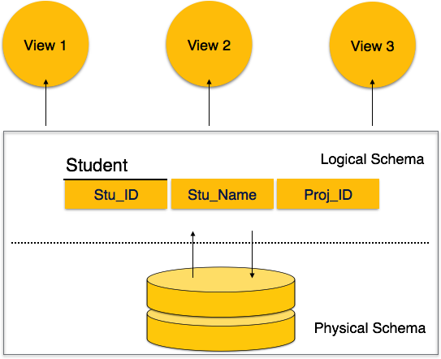

Slide 84
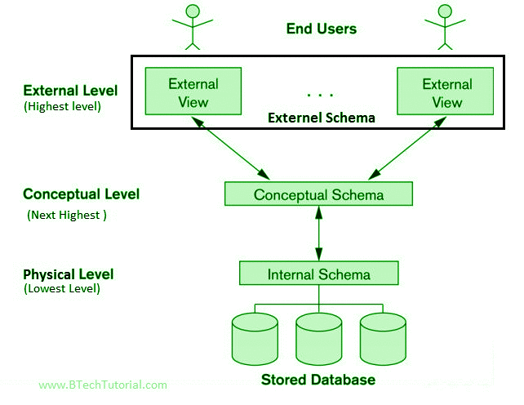

Slide 85
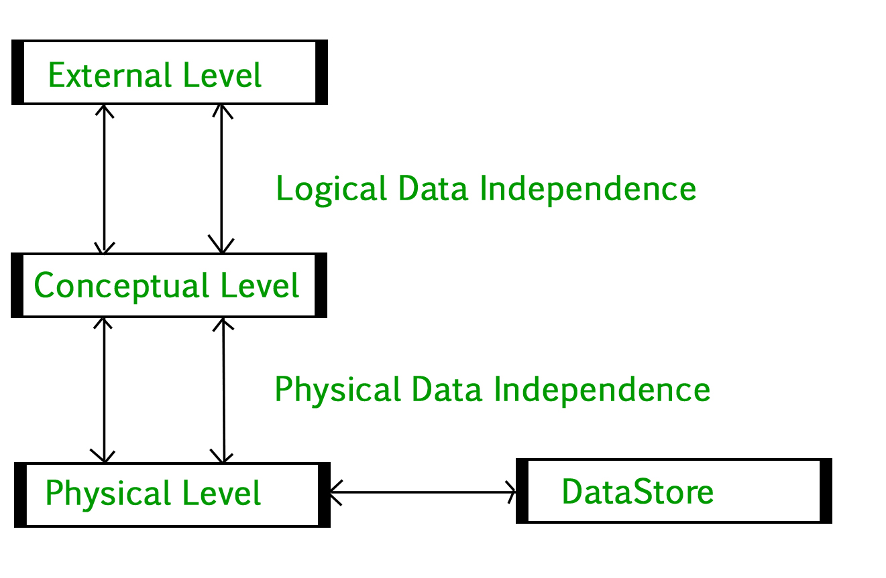

Slide 86
Data Independence
Applications insulated from how data is structured and stored.
Logical data independence: Protection from changes in logical structure of data.
Physical data independence: Protection from changes in physical structure of data.

Slide 87
Levels of Abstraction
Many views, single conceptual (logical) schema and physical schema.
  Views describe how users see the data.
  Conceptual schema defines logical structure
  Physical schema describes the files and indexes used.
View 1
View 2
View 3
Conceptual Schema
Physical Schema
Notes:
6

Slide 88
Database Languages
A database system provides a data definition language to specify the database schema and a data manipulation language to express database queries and updates.
The data definition and data manipulation languages are not two separate languages.
instead they simply form parts of a single database language, such as the widely used SQL language

Slide 89
Data-Definition Language
Specify a database schema by a set of definitions expressed by a special language called a data-definition language (DDL).
the following statement in the SQL language defines the account table:
Create table account(account-number char(10),balance integer).

Slide 90
DDL
DDL statement creates the account table.
it updates a special set of tables called the data dictionary or data directory.

Slide 91
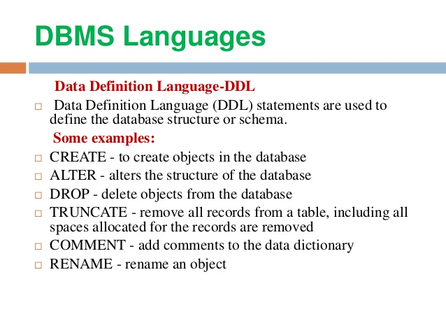

Slide 92
Database Languages
A data dictionary contains metadata—that is, data about data.
The schema of a table is an example of metadata.
A database system consults the data dictionary before reading or modifying actual data.

Slide 93
Database Languages
specify the storage structure and access methods used by the database system by a set of statements in a special type of DDL called a data storage and definition language.
These statements define the implementation details of the database schemas, which are usually hidden from the users

Slide 94
Database Languages
The data values stored in the database must satisfy certain consistency constraints.
For example, suppose the balance on an account should not fall below $100.
The DDL provides facilities to specify such constraints.
The database systems check these constraints every time the database is updated

Slide 95
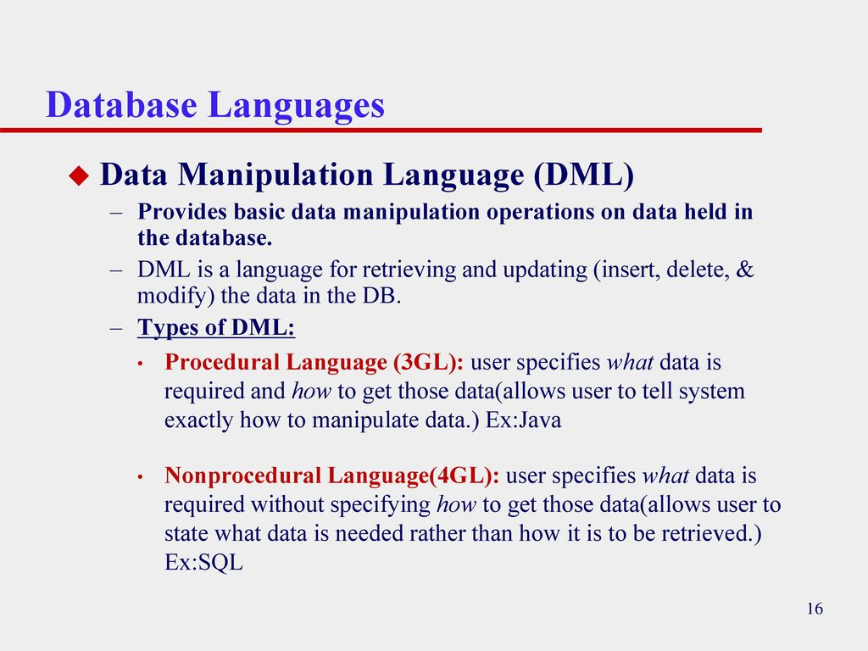

Slide 96
Data-Manipulation Language
Data manipulation is
The retrieval of information stored in the database
The insertion of new information into the database
The deletion of information from the database
The modification of information stored in the database

Slide 97
DML
A data-manipulation language (DML) is a language that enables users to access or manipulate data as organized by the appropriate data model.
There are basically two types:

Slide 98
DML
Procedural DMLs require a user to specify what data are needed and how to get those data.
Declarative DMLs (also referred to as nonprocedural DMLs) require a user to specify what data are needed without specifying how to get those data.

Slide 99
DML..
Declarative DMLs are usually easier to learn and use than are procedural DMLs.
since a user does not have to specify how to get the data, the database system has to figure out an efficient means of accessing data.
The DML component of the SQL language is nonprocedural

Slide 100
QUERY
A query is a statement requesting the retrieval of information.
The portion of a DML that involves information retrieval is called a query language
This query in the SQL language finds the name of the customer whose customer-id is 192-83-7465:
select customer.customer-name
from customer
where customer.customer-id = 192-83-7465

Slide 101
Database Users and Administrators
A primary goal of a database system is to retrieve information from and store new information in the database.
People who work with a database can be categorized as database users or database administrators

Slide 102
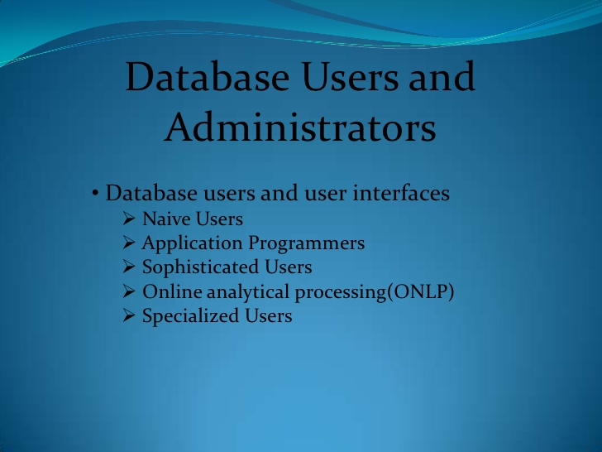

Slide 103
Database Users and User Interfaces
There are four different types of database-system users, differentiated by the way they expect to interact with the system.
Different types of user interfaces have been designed for the different types of users.

Slide 104
Naive users
Naive users are unsophisticated users who interact with the system by invoking one of the application programs that have been written previously.
For example, a bank teller who needs to transfer $50 from account A to account B invokes a program called transfer.
This program asks the teller for the amount of money to be transferred, the account from which the money is to be transferred, and the account to which the money is to be transferred.

Slide 105
Naive users
As another example, consider a user who wishes to find her account balance over the World Wide Web. Such a user may access a form, where she enters her account number.
An application program at the Web server then retrieves the account balance, using the given account number, and passes this information back to the user.
The typical user interface for naive users is a forms interface, where the user can fill in appropriate fields of the form

Slide 106
Application programmers
Application programmers are computer professionals who write application programs.
Application programmers can choose from many tools to develop user interfaces.
Rapid application development (RAD) tools are tools that enable an application programmer to construct forms and reports without writing a program.
There are also special types of programming languages that combine imperative control structures (for example, for loops, while loops and if-then-else statements) with statements of the data manipulation language.
These languages, sometimes called fourth-generation languages, include special features to facilitate the generation of forms and the display of data on the screen.
Most major commercial database systems include a fourth generation language.

Slide 107
Sophisticated users
interact with the system without writing programs. Instead,they form their requests in a database query language.
They submit each such query to a query processor, whose function is to break down DML statements into instructions that the storage manager understands.
Analysts who submit queries to explore data in the database fall in this category.

Slide 108
Sophisticated users
Online analytical processing (OLAP) tools simplify analysts’ tasks by letting them view summaries of data in different ways.
For instance, an analyst can see total sales by region (for example, North, South, East, and West), or by product, or by a combination of region and product (that is, total sales of each product in each region).
The tools also permit the analyst to select specific regions, look at data in more detail (for example, sales by city within a region) or look at the data in less detail (for example, aggregate products together by category).
Another tools for analysts is data mining tools, which help them find certain kinds of patterns in data

Slide 109
Specialized users
Specialized users are sophisticated users who write specialized database applications that do not fit into the traditional data-processing framework.
computer-aided design systems, knowledgebase and expert systems, systems that store data with complex data types (for example, graphics data and audio data), and environment-modeling systems.

Slide 110
Database Administrator
One of the main reasons for using DBMSs is to have central control of both the data and the programs that access those data.
A person who has such central control over the system is called a database administrator (DBA).

Slide 111
Functions of Database Administrator
Schema definition.
Storage structure and access method definition.
Schema and physical organization modification.
Granting of authorization for data access.
Integrity constraint specification.

Slide 112
DBA Responsibilities
Schema definition. The DBA creates the original database schema by executing a set of data definition statements in the DDL.
Storage structure and access-method definition.
Schema and physical-organization modification. The DBA carries out changes to the schema and physical organization to reflect the changing needs of the organization, or to alter the physical organization to improve performance.

Slide 113
DBA Responsibilities
Granting of authorization for data access. By granting different types of authorization, the database administrator can regulate which parts of the database various users can access.
The authorization information is kept in a special system structure that the database system consults whenever someone attempts to access the data in the system

Slide 114
DBA Responsibilities
Routine maintenance. Examples of the database administrator’s routine maintenance activities are:
Periodically backing up the database, either onto tapes or onto remote servers, to prevent loss of data in case of disasters such as flooding.
Ensuring that enough free disk space is available for normal operations, and upgrading disk space as required.
Monitoring jobs running on the database and ensuring that performance is not degraded by very expensive tasks submitted by some users.

Slide 115
Database System Structure
A database system is partitioned into modules that deal with each of the responsibilities of the overall system.
The functional components of a database system can be broadly divided into the storage manager and the query processor components.

Slide 116
Storage Manager
A storage manager is a program module that provides the interface between the low level data stored in the database and the application programs and queries submitted to the system.
The storage manager is responsible for the interaction with the file manager.
The raw data are stored on the disk using the file system, which is usually provided by a conventional operating system.
The storage manager translates the various DML statements into low-level file-system commands.
Thus, the storage manager is responsible for storing, retrieving, and updating data in the database.

Slide 117
The storage manager components include
Authorization and integrity manager, which tests for the satisfaction of integrity constraints and checks the authority of users to access data.
Transaction manager, which ensures that the database remains in a consistent (correct) state despite system failures, and that concurrent transaction executions proceed without conflicting.
File manager, which manages the allocation of space on disk storage and the data structures used to represent information stored on disk.
Buffer manager, which is responsible for fetching data from disk storage into main memory, and deciding what data to cache in main memory.
The buffer manager is a critical part of the database system, since it enables the database to handle data sizes that are much larger than the size of main memory

Slide 118
storage manager
The storage manager implements several data structures as part of the physical system implementation
Data files, which store the database itself.
Data dictionary, which stores metadata about the structure of the database, in particular the schema of the database.
Indices, which provide fast access to data items that hold particular values

Slide 119
The Query Processor
The query processor components include
DDL interpreter, which interprets DDL statements and records the definitions in the data dictionary.
DML compiler, which translates DML statements in a query language into an evaluation plan consisting of low-level instructions that the query evaluation engine understands.
A query can usually be translated into any of a number of alternative evaluation plans that all give the same result.
The DML compiler also performs query optimization, that is, it picks the lowest cost evaluation plan from among the alternatives.
Query evaluation engine, which executes low-level instructions generated by the DML compiler.

Slide 120
